Slide 1
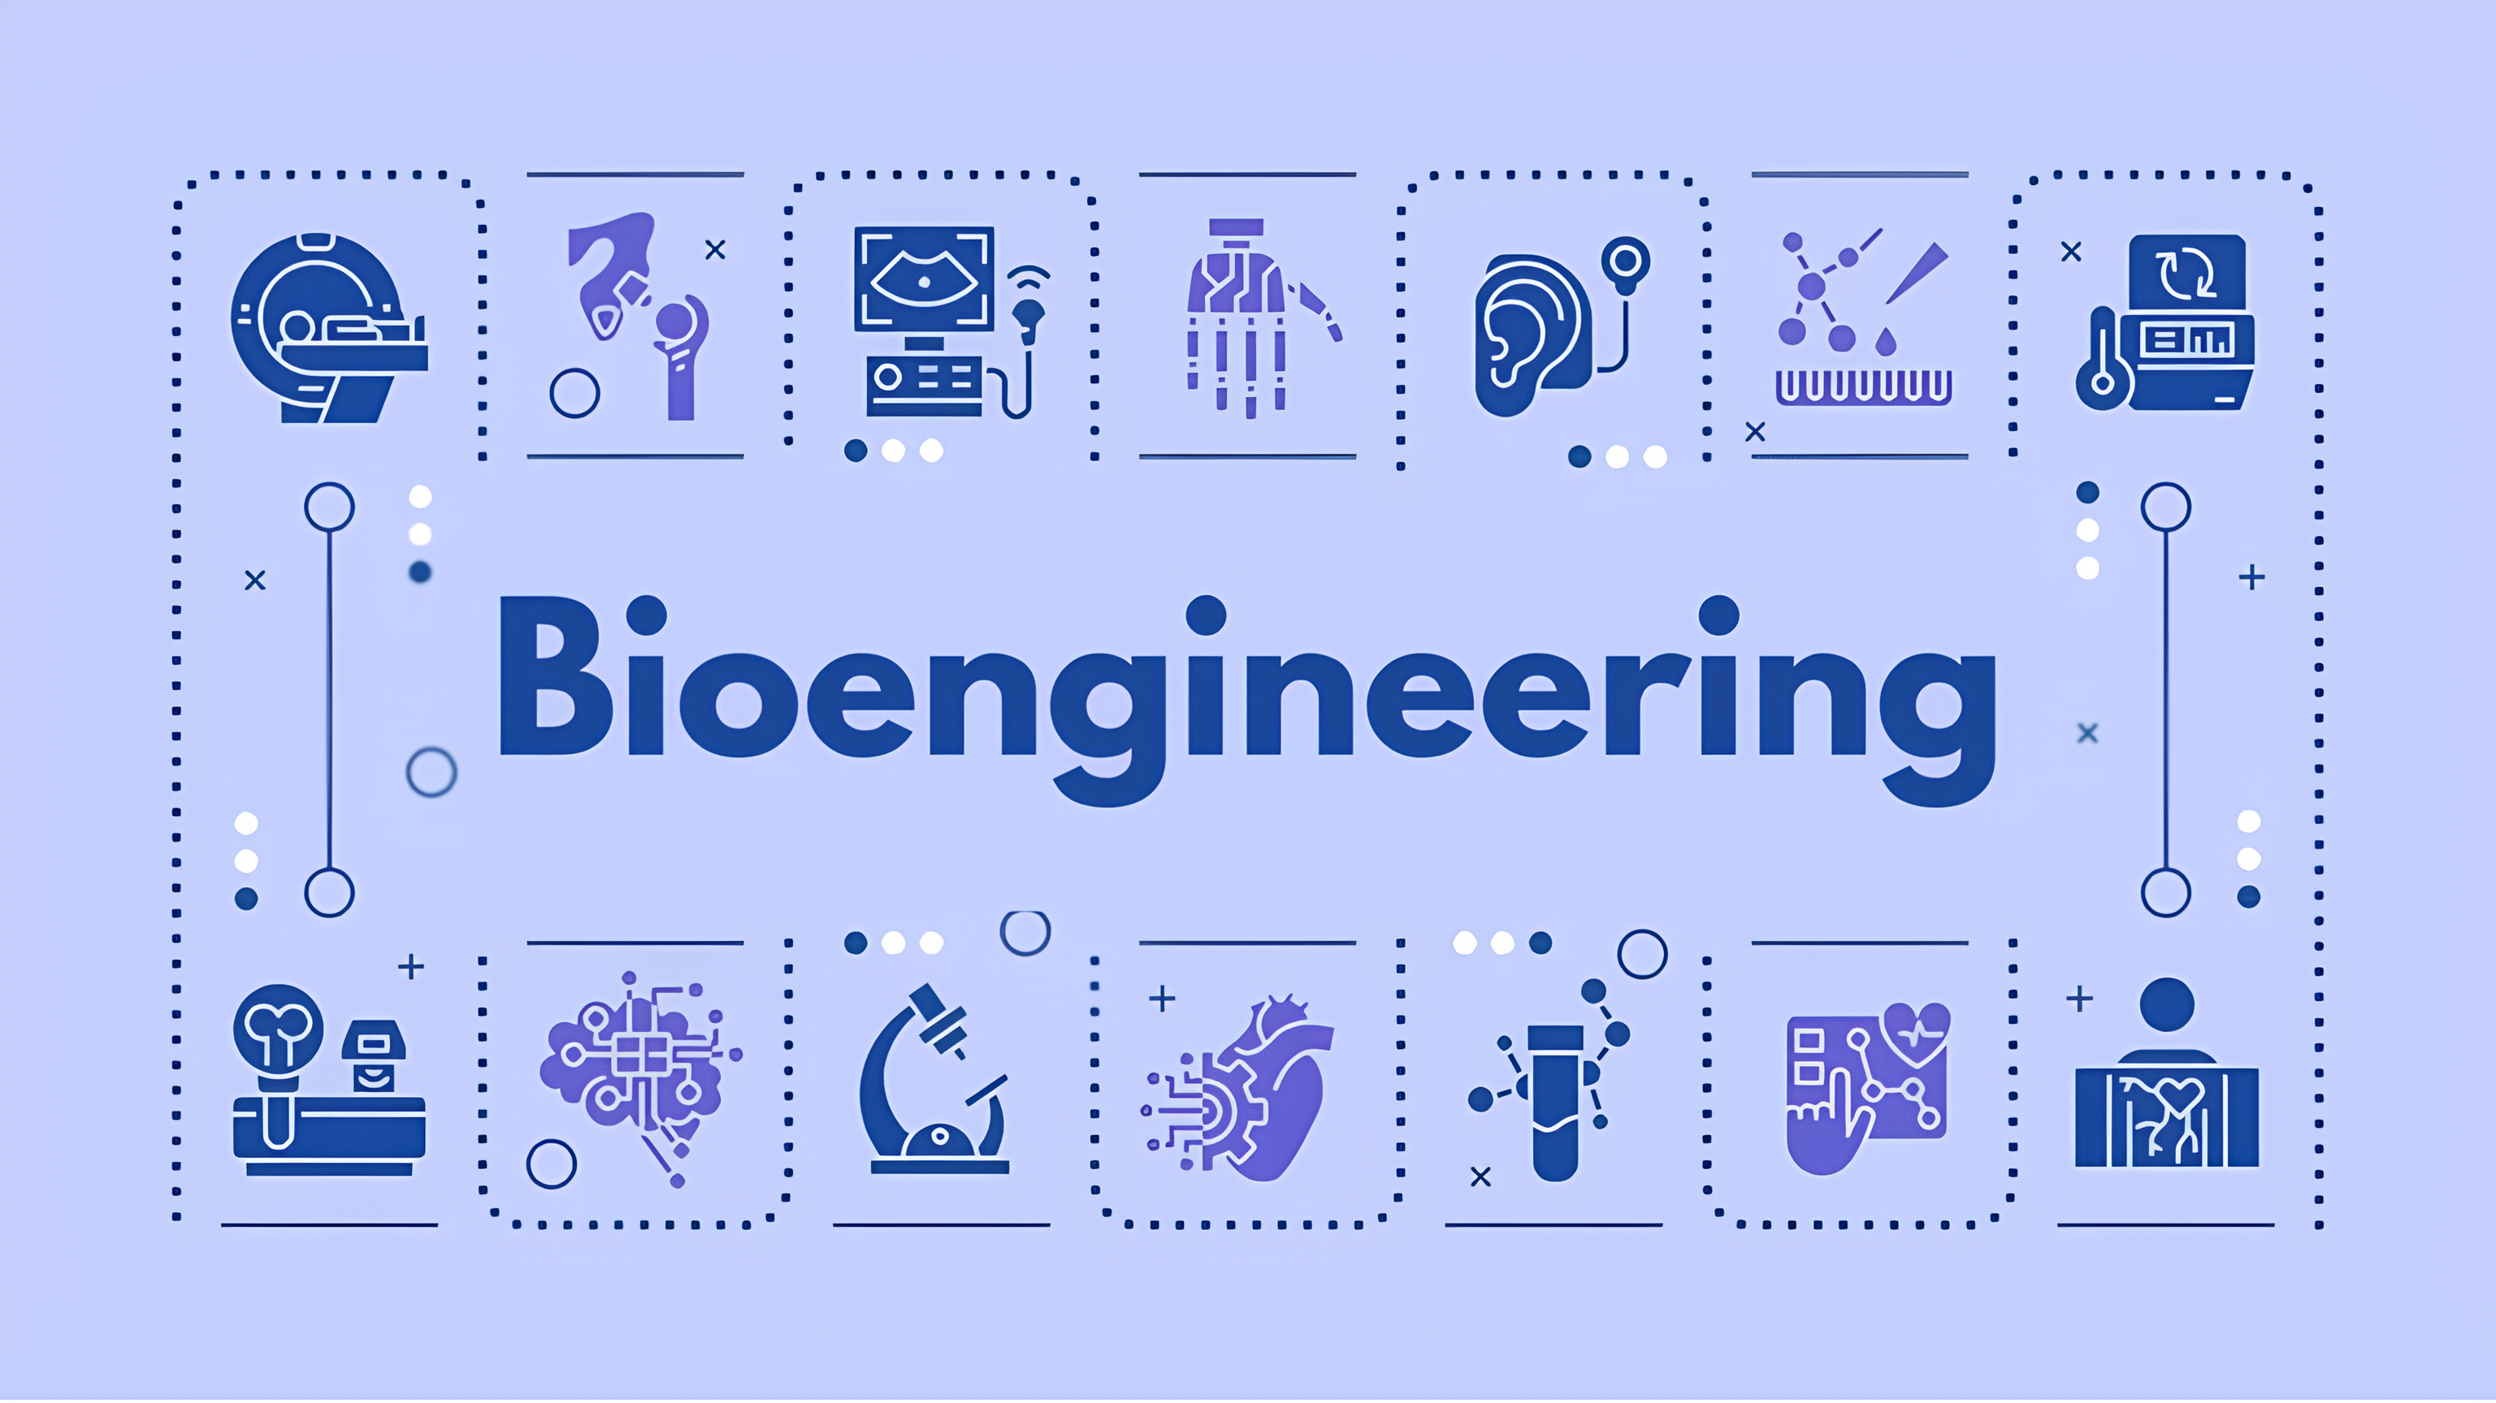

Slide 2
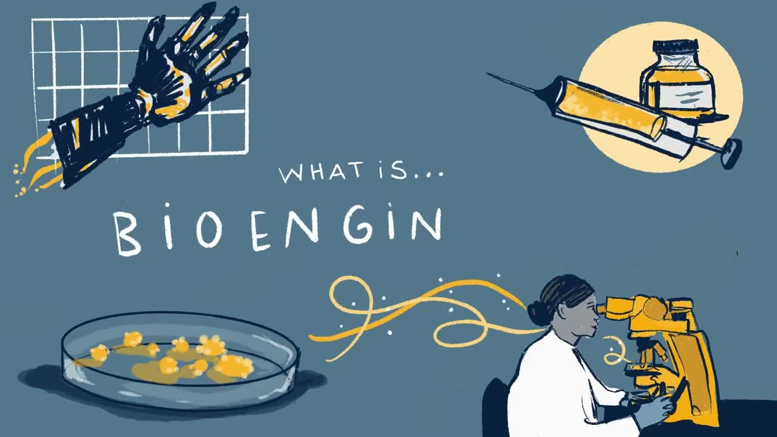

Slide 3
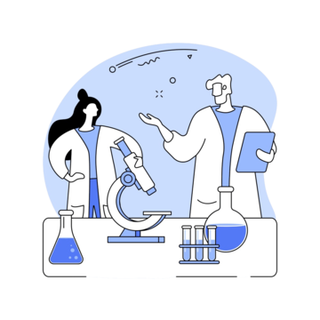

Bioengineering
An interdisciplinary field that applies principles from biology, chemistry, physics, and engineering to solve problems related to living systems.

Slide 4

HOW CAN I USE TECHNOLOGY TO
UNDERSTAND & SOLVE MEDICAL PR0BLEMS?

Slide 5
TIMELINE OF MAJOR ADVANCES
1920
1950
1973
1980
1990
2005
2020
Discovery of
Insulin
First Artificial Heart Valve
First Successful Gene Cloning
The First Recombinant DNA Drug
The Human Genome Project Initiation
Development of CRISPR-Cas9 Technology
COVID-19 mRNA Vaccines

Slide 6

1
2
4
3
Impact on medicine
Current innovations
Future ideas
Historical Background

Slide 7
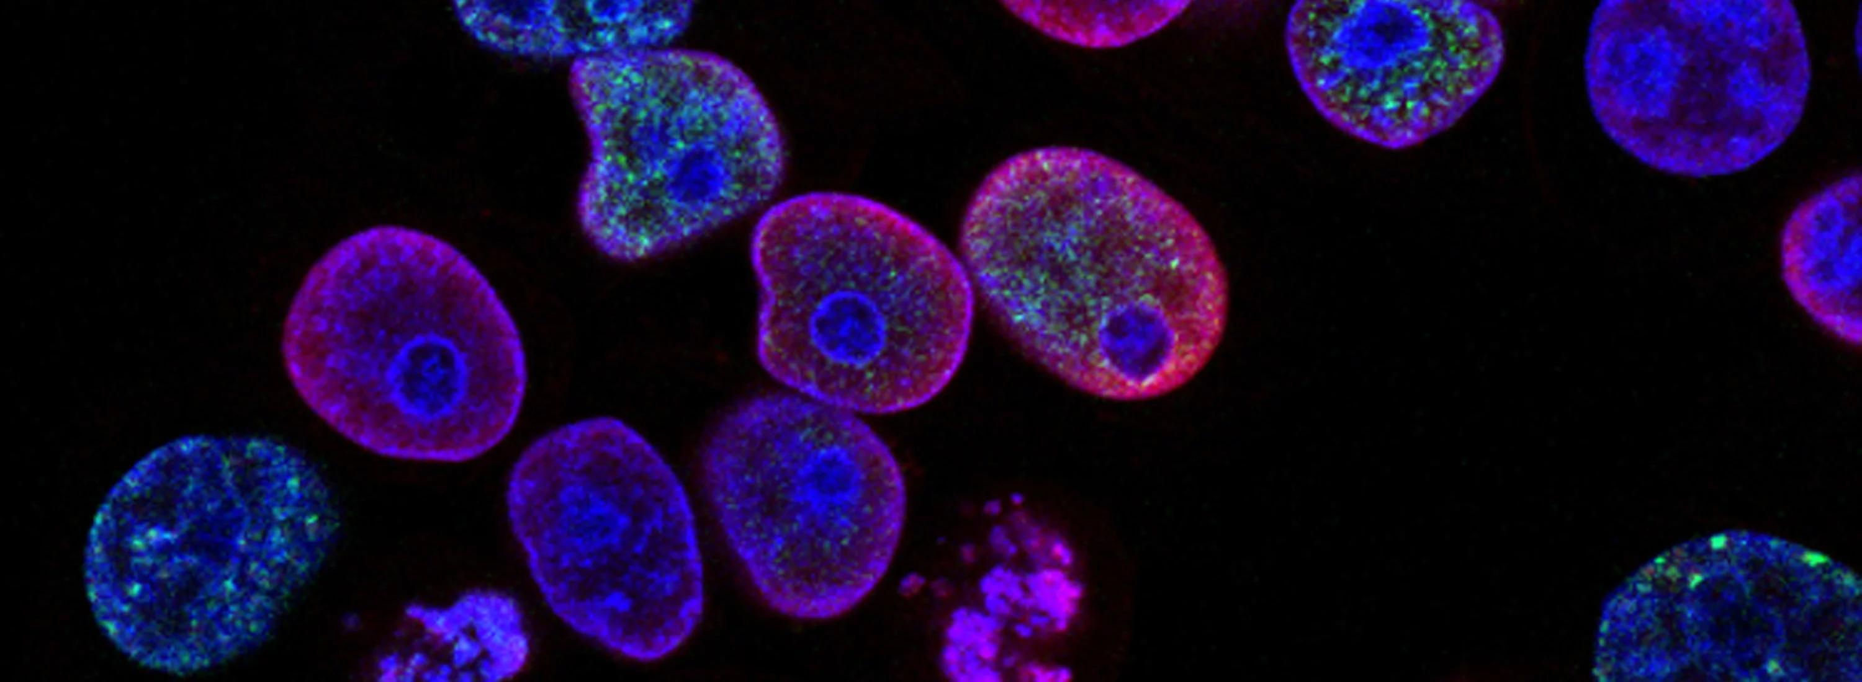

Slide 8
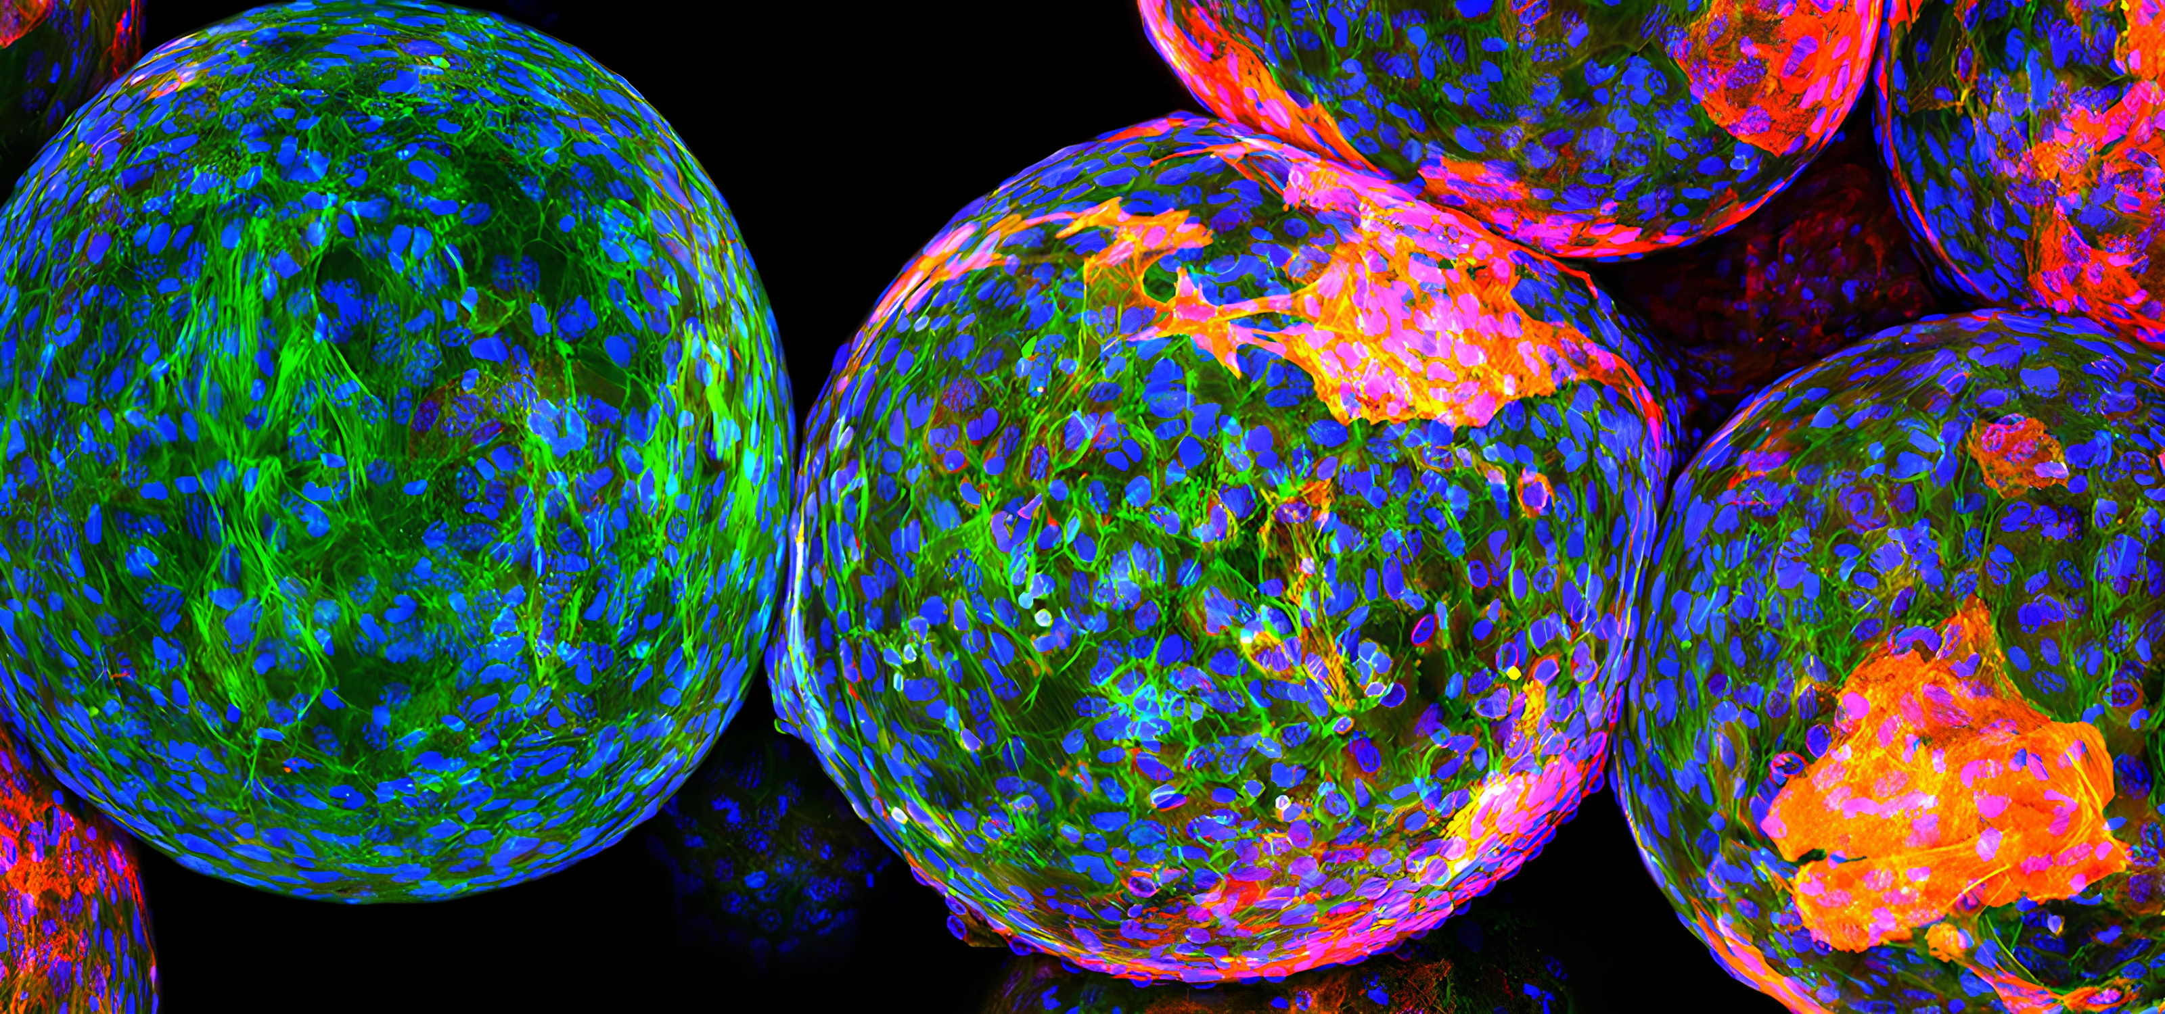

Slide 9


REFERENCES
WEBSITES
IEEE
SciTechDaily
News Medical Life Sciences
BOOKS
Engineering: A Very Short Introduction
by David Blockley
Introduction to Bioengineering
by S. A. Berger, W. Goldsmith, E. R. Lewis

